Slide 1



TEAM FALCONS
E – KART PRESENTATION
TEAM NAME : TEAM FALCONS
TEAM VIN NO : 2606EV401
COLLEGE NAME : KNOWLEDGE INSTITUTE OF TECHNOLOGY
MOTOR CATEGORY : 5 KW

Slide 2
TEAM STRUCTURE
S.NO | NAME | DESIGNATION
1 | Gokul Ramana D | CAPTAIN
2 | Santhosh G | VICE CAPTAIN
3 | Yogesh | DRIVER
4 | Santhosh G | DRIVER
5 | Bhuvanan M | DESIGN HEAD
6 | Palaniyappan A | DESIGN
7 | Santhosh G | DESIGN
8 | Logeshwaran K | DESIGN
9 | Goutham S | DESIGN
10 | Aravinth R | FABRICATION HEAD
11 | Santhosh | FABRICATION
12 | Mahesh raj | FABRICATION
13 | Dharanesh | FABRICATION
14 | Kanishkar E | FABRICATION
15 | Aswin j | BRAKING HEAD
16 | Dheepak S | BRAKING
17 | Mohanraj | BRAKING
18 | Vishal | STEERING &WHEEL HEAD
19 | Vishnuvarathan | STEERING &WHEEL
20 | Surya K | STEERING &WHEEL
21 | Jagadeeswaran K | Electrical & Transmission Head
22 | Dravid M | Electrical & Transmission
23 | Meiguru Prasath | Electrical & Transmission
24 | Santhosh R | Driver Percy, Ergonomics& Aesthetic Head
25 | Santhosh S | Driver Percy, Ergonomics& Aesthetic
26 | Arjun | Driver Percy, Ergonomics& Aesthetic
27 | Gowrishankar T | Innovation Head
28 | Pragadeesh A | Innovation
29 | Praveenraj | Innovation
30 | Kishor S | Innovation

Slide 3
ABSTRACT
The objective of this project is to design, fabricate, and successfully implement an electric go-kart powered by an efficient electric drive system. The project aims to analyze and understand the fundamentals of electric vehicle technology, including energy storage, power management, and motor control. Special emphasis is given to chassis design, weight distribution, braking efficiency, and driver safety to ensure stable and reliable performance. The project also focuses on optimizing energy consumption to improve range and efficiency under practical operating conditions. Through this work, technical skills related to mechanical fabrication, electrical wiring, component integration, and system testing are enhanced. Additionally, the project promotes innovation, teamwork, and problem-solving abilities while supporting the development of sustainable, low-emission transportation solutions.

Slide 4
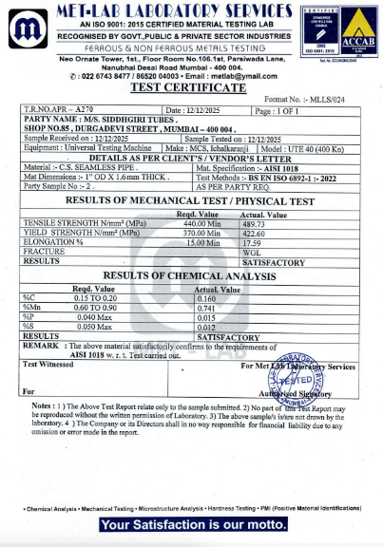
CHASIS MATERIAL & TESTING REPORT
CHASIS MATERIAL:
Material grade : AISI 4130
Outer diameter : 25.4 mm
Thickness :1.6 mm
MATERIAL PROPERTIES:
Density : 7850 kg/m
Young’s modulus : 205 gpa
Poisson’s Ratio : 0.29
Yeild strength : 435 Mpa
Ultimate Tensile Strength : 560 Mpa

Slide 5
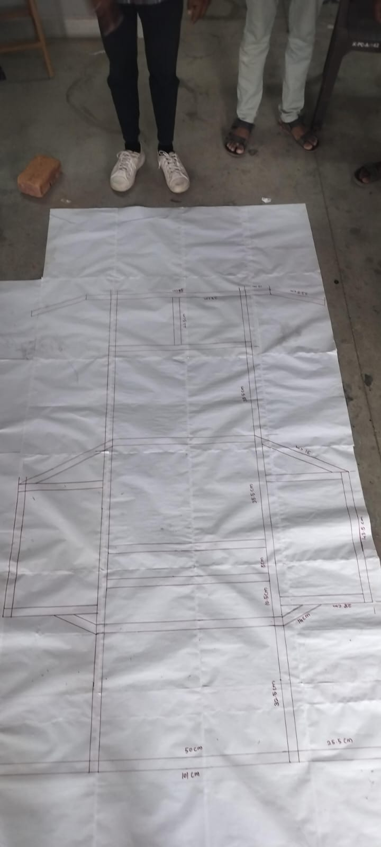
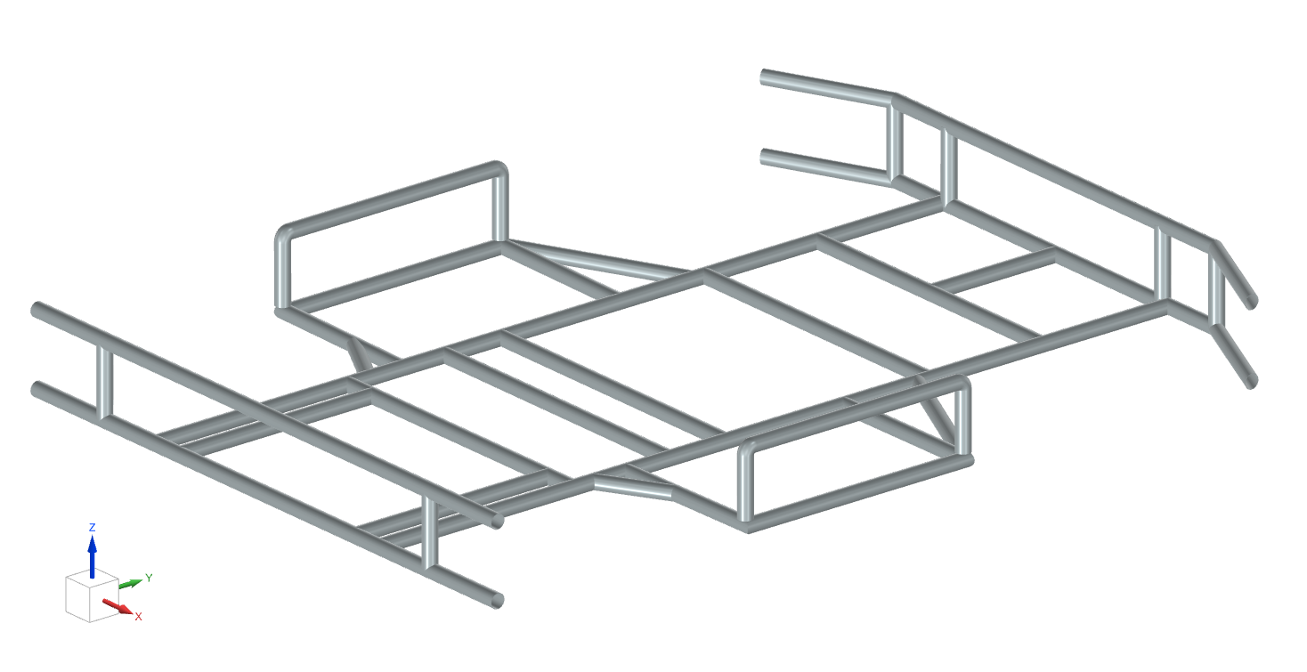
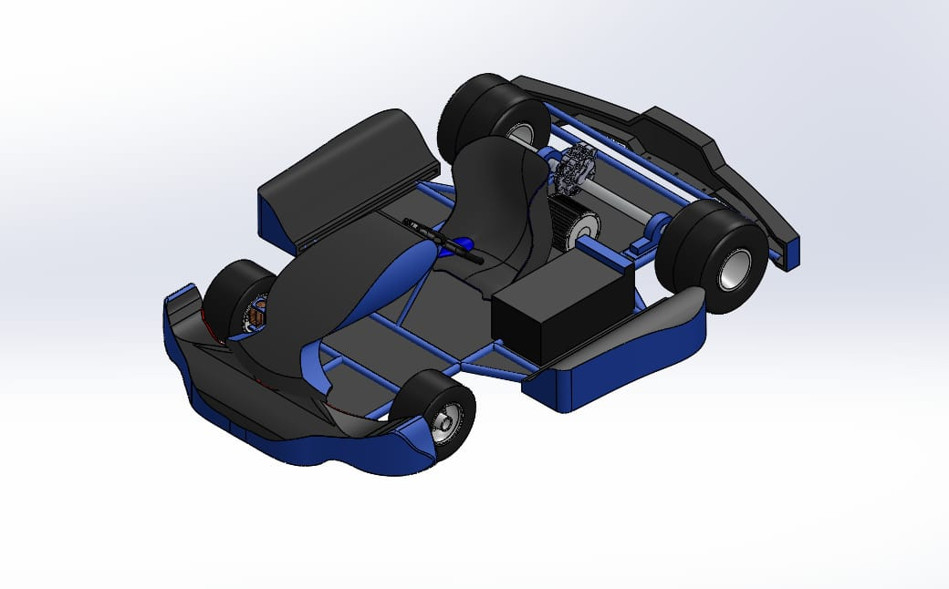
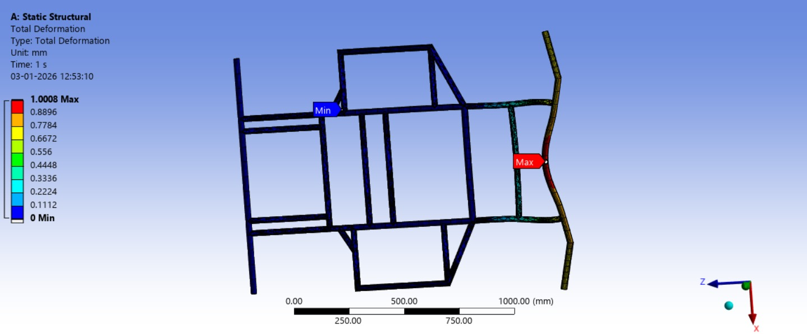
DESIGN METHODOLOGY
Vehicle requirements were studied and the initial chassis layout was prepared using hand sketches.
The 3D chassis model was designed using SolidWorks
.
Structural analysis was performed in ANSYS Workbench to verify strength and deformation.
The optimized design was finalized for assembly and fabrication.

Slide 6
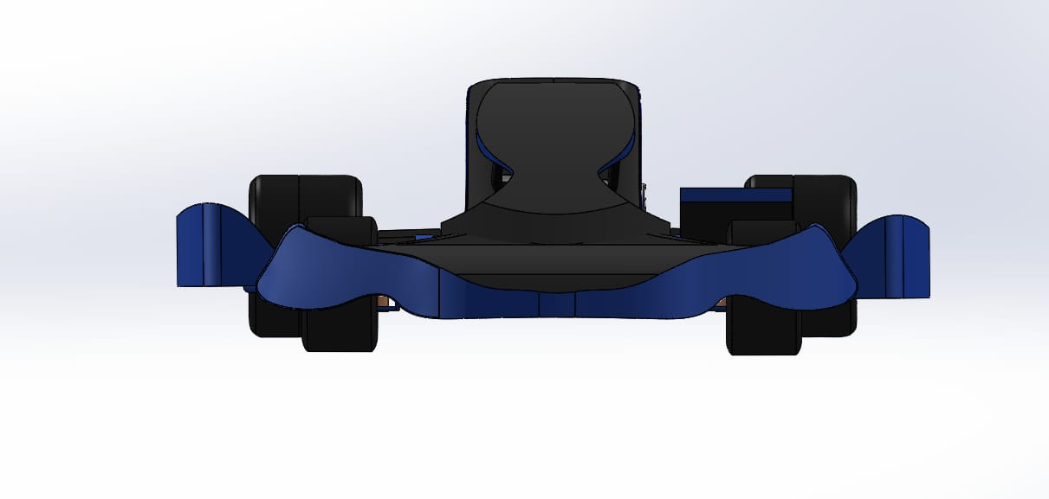
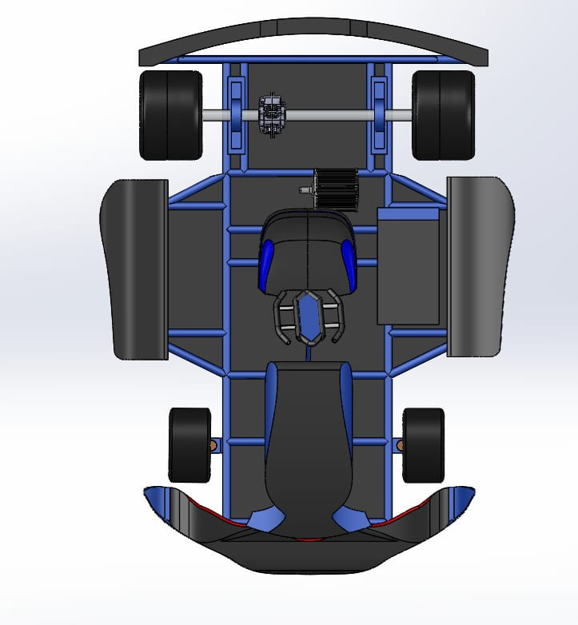
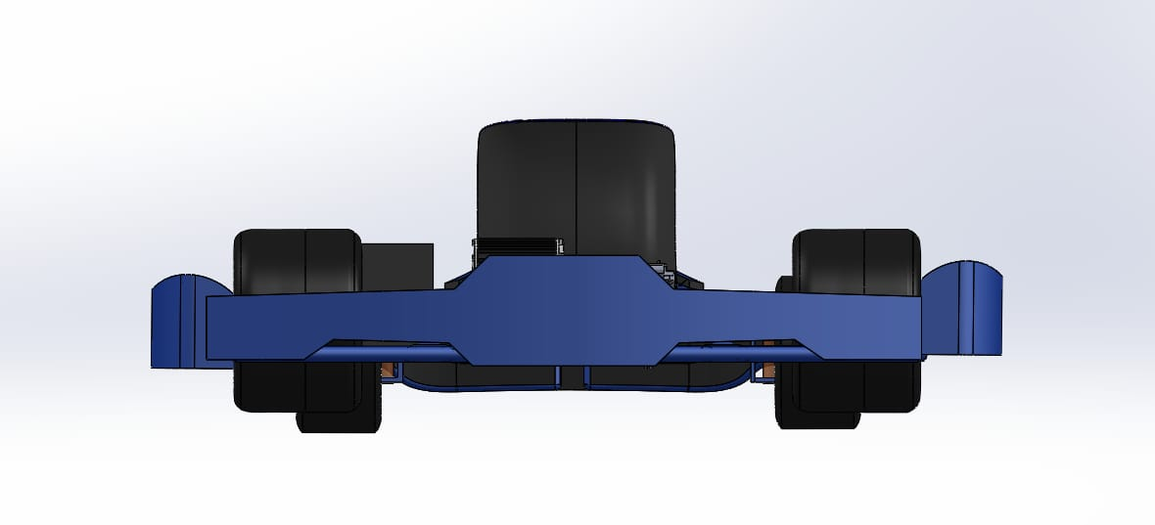
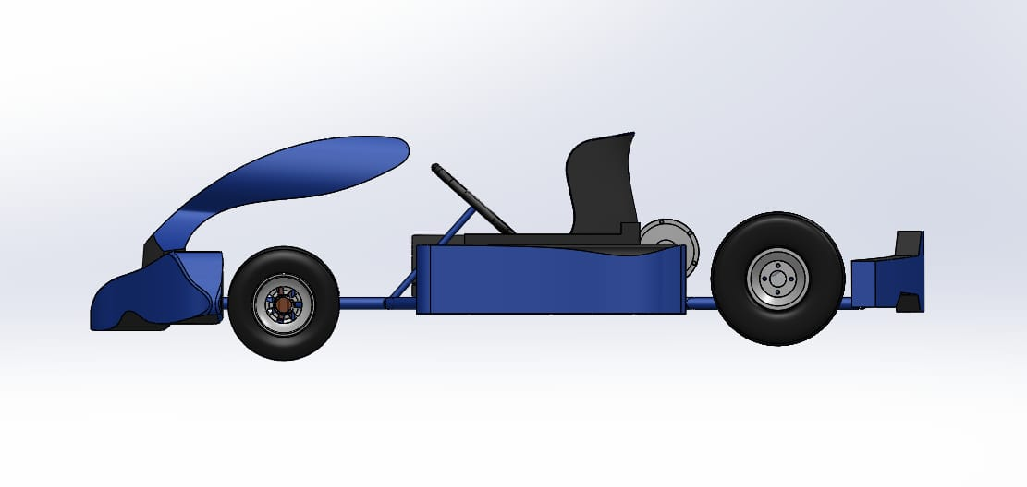
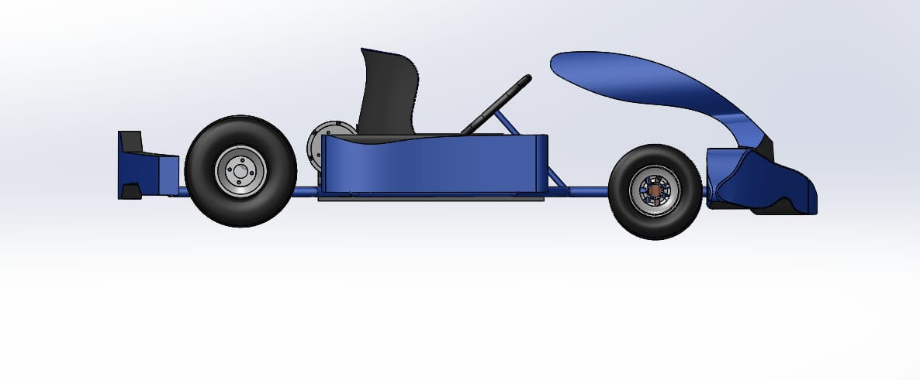
VECHICLE VIEWS
Parameter | Value | Unit
Material Utilized | AISI 4130 | –
Young’s Modulus (E) | 205 | GPa
Yield Strength | 435 | MPa
Ultimate Tensile Strength | 560 | MPa
Density | 7850 | kg/m³
Bending Strength | ≤ 435 | MPa
FRONT VIEW
TOP VIEW
REAR VIEW
LEFT SIDE VIEW
ISOMATRIC VIEW
RIGHT SIDE VIEW

Slide 7
E-KART FULL ASSEMBLY

Slide 8
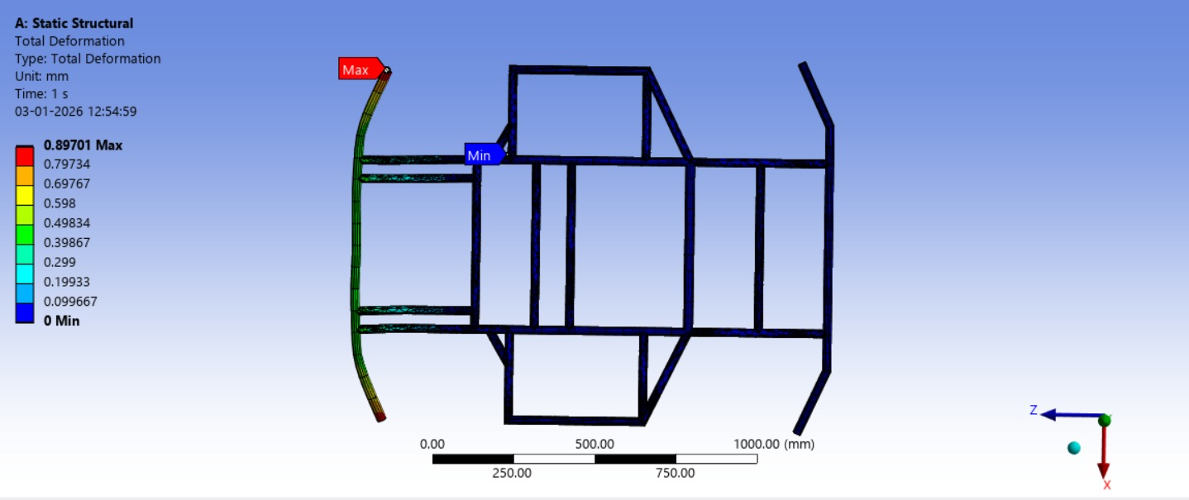
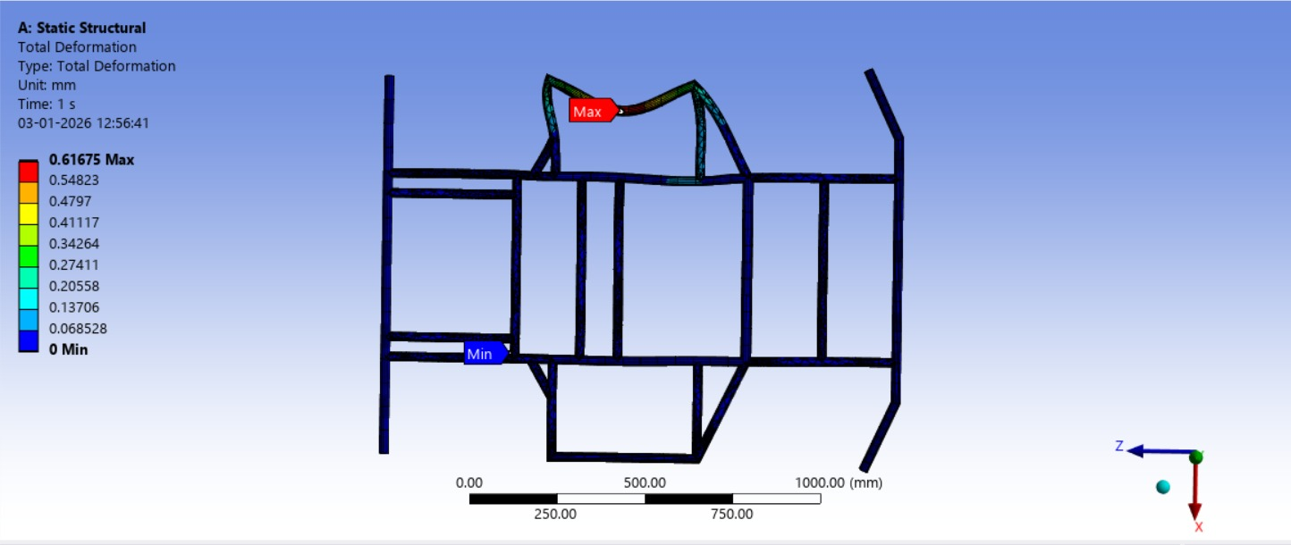
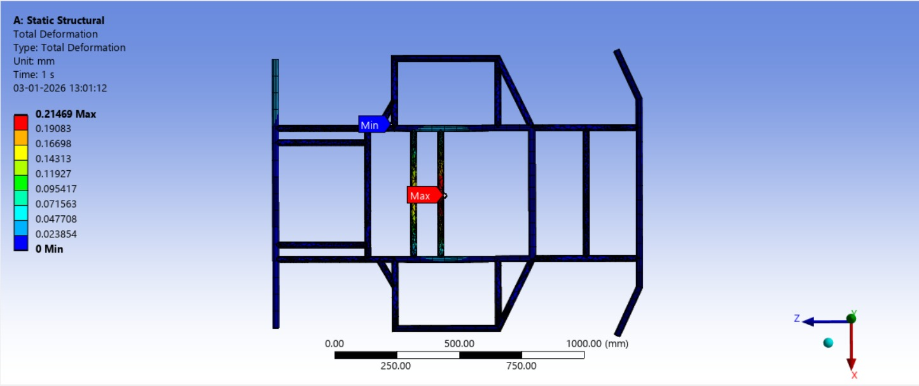
Chassis Analysis
FRONT VIEW | REAR VIEW | SIDE VIEW | Roll Over
APPLIED LOAD (N) : 3000 | APPLIED LOAD (N) : 3000 | APPLIED LOAD (N) : 3000 | APPLIED LOAD (N) : 3000
TOTEL DEFORMATION (mm) : 1.0008 | TOTEL DEFORMATION (mm) : 0.897 | TOTEL DEFORMATION (mm) : 0.616 | TOTEL DEFORMATION (mm) : 0.214
FACTORY OF SAFETY (FOS) : 0.16 | FACTORY OF SAFETY (FOS) : 0.18 | FACTORY OF SAFETY (FOS) : 0.15 | FACTORY OF SAFETY (FOS) :1.2

Slide 9
KART VEHICLE GENERAL DIMENSIONS
S. No | Parameter
1 | Overall length | 1700 mm
2 | Wheel base | 1100 mm
3 | Front wheel track | 700 mm
4 | Rear wheel track | 720 mm
5 | Ground clearance | 50 mm
6 | Overall height | 900 mm
Break type | Rear brake disc
Disc Size | 220 mm
Disc Thickness | 4.0 mm
Front tyre | 10 X 4.7 X 5 in
Rear Tyre | 11 X 7.1 X 5 in

Slide 10
KART VEHICLE GENERAL DIMENSIONS
MOTOR AND CONTROLLER SPECIFICATION
ACCUMULATOR / BATTERY SPECIFICATION
S.No | Parameter | Specification
1 | Motor Manufacturer & Model | DATAI – DATAI 60-5000-150
2 | Type of Motor Used | PMSM (Permanent Magnet Synchronous Motor)
3 | Motor Power (kW) | 5 kW (Max allowed: 6 kW)
4 | Nominal Motor Voltage (Phase & Volt) | 6-Phase, 60 V DC
5 | Maximum Design Motor RPM | 3800 rpm
6 | Maximum Motor Torque (Peak) | 58 Nm
7 | Maximum Motor Torque (Continuous) | 16 Nm
8 | Maximum Motor Power (Peak) | 9 kW @ 3800 rpm
9 | Maximum Motor Power (Continuous) | 5 kW @ 3000 rpm
10 | Motor Controller Type & Model | PMSM Controller – DATAI
11 | Motor Controller Discharge Power (Peak) | 10 kW
12 | Motor Controller Discharge Power (Continuous) | 5–6 kW
S.No | Parameter | Specification
1 | Type of Battery / Accumulator | Lithium-ion Battery Pack
2 | Individual Cell Voltage / Capacity | 3.7 V, ~3000 mAh
3 | Individual Cell Voltage Limits | Min: 3.0 V, Max: 4.2 V
4 | Battery Pack Voltage (Fully Charged) | 67.2 V
5 | Battery Pack Nominal Voltage | 60 V
6 | Battery Pack Capacity | 90 Ah
7 | Battery Cell Technology / Chemistry | Lithium-ion (NMC)
8 | Number of Cells (Series × Parallel) | 16S × 30P (Approx.)
9 | Battery Discharge Power (Peak) | ~9 kW (for short duration)
10 | Battery Discharge Power (Continuous) | ~5 kW
11 | Battery Full Charging Time | 5–6 hours
12 | Battery Charging Efficiency | 90–95 %
13 | Battery Charging Power | 1.5–2.0 kW
14 | Cooling System | Passive Air Cooling
15 | Other Special Components | Battery Management System (BMS)
16 | Auxiliary Battery Specifications | DC-DC Converter (48–72 V input, 12 V / 15 A output)

Slide 11
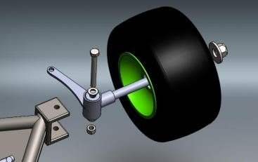
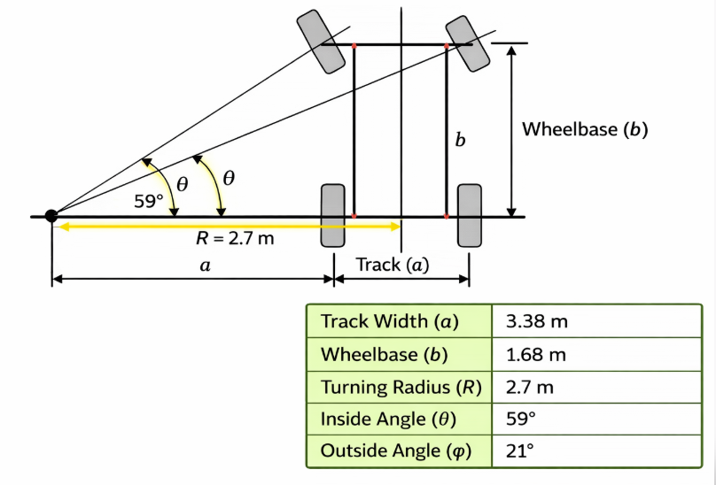
DESIGNING OF STEERING SYSTEM & WHEEL GEOMETRY
Steering Parameter | Respective Values
Steering Wheel Radius | 5 inch
Mechanical Linkage Ratio | 10:1
Ackerman Percentage | 37.5
Ackerman Angle | Inside = 21 ° Outside =59 °
Turning Radius | 2.7m
Lock To Lock Distance | -230° to +230°
Inside Angle | Outside Angle | Turning Radius
10° | 9.00° | 6.47 m
20° | 16.44° | 3.376 m
30° | 22.86° | 2.36 m
40° | 28.63° | 1.88 m

Slide 12
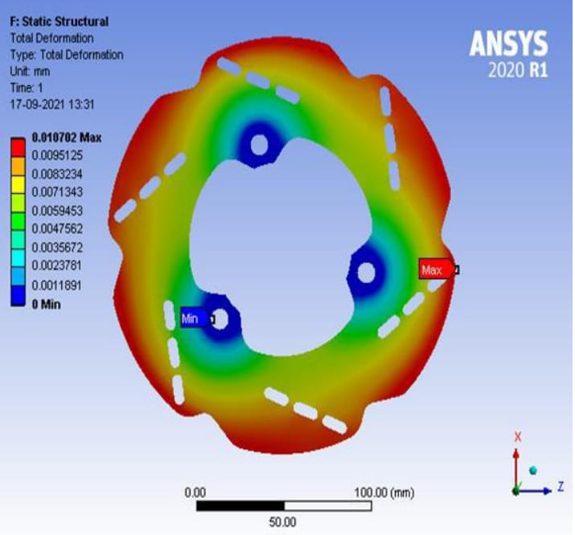
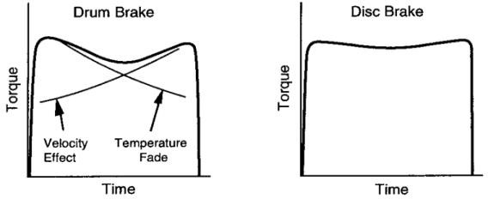
DESIGNING OF BRAKING SYSTEM & WEIGHT DISTRIBUTION
Parameter | Value / Note
Brake Pedal Ratio | 4–5:1
Human Pedal Force | ~300–400 N
Master Cylinder Force | Pedal ratio × human force
Brake Line Pressure | P = F / A (A = caliper piston area)
Clamping Force | Piston area × hydraulic pressure
Brake Torque | T = F × R (R ≈ 0.11–0.12 m)
Friction Coefficient | Pad vs Disc ≈ 0.35–0.4
Thermal Note | Rear brakes heat less; disc thickness ~4–5 mm
Tyre-Road Friction | µ ≈ 0.7
Stopping Distance/Time | From kart mass, speed, brake torque; t = v / a
Parameter | Value / Note
Fig. Disk vs. drum Graph

Slide 13
POWER TRAIN CALCULATION & ELECTRICALS
Category | Component | Specification / Description
Electrical Components | Auxiliary System Type | 12 V DC auxiliary system
 | Auxiliary Battery / Accumulator | 12 V DC battery for controls & lighting
 | DC–DC Converter | 60 V–12 V DC, 15 A rated
Safety Systems | Fuse Type & Rating | Automotive blade fuse, 150 A
 | MCB Type & Rating | DC MCB, 150 A
 | Accumulator Isolation Relay (AIR) | High-voltage DC contactor
 | Anderson Connector | Anderson SB series, 175 A
 | Ignition Switch | Key type, dashboard mounted
 | Kill Switch | Push/Pull type, rear accessible
 | Tractive System Disconnect (TSD) | Manual service disconnect
Warning Systems | Electrical Innovation (if any) | Smart monitoring using sensors
 | Display | Digital LCD, 12 V
 | TSAL | Red LED indicator, HV active
 | RTDS | Buzzer-based audible alert
 | Battery Management System (BMS) | Cell monitoring & protection system
Parameter | Specification
Motor Configuration | 5 kW, 60 V PMSM (within 6 kW limit)
Power Transmission Type | Chain Drive
Motor Sprocket Teeth | 12 Teeth
Motor Sprocket Diameter | ~60 mm
Final Gear Teeth | 48 Teeth
Final Gear Diameter | ~240 mm
Final Drive Ratio | 4 : 1
Drive Shaft Diameter | 25 mm
Keyway Dimension | 8 mm × 7 mm (Parallel Key)

Slide 14
Circuit Diagram of HLVC & GLVC System
Parameter | HLV (High Line Voltage) | GLV (Ground Low Voltage)
Voltage Level | High voltage used for propulsion and charging | Low voltage (12V / 5V) used for control
Application | Motor, inverter, high-power wiring | ECU, sensors, display, relays
Current Level | High current | Low current
Safety Requirement | Requires insulation, shielding, and interlocks | Safe for handling and testing
Electrical Isolation | Isolated from GLV system | Common ground reference
Cable Color Code | Orange | Red (Positive), Black (Ground)
Signal / Control Lines | Not applicable | Yellow (signals), Blue (safety)

Slide 15

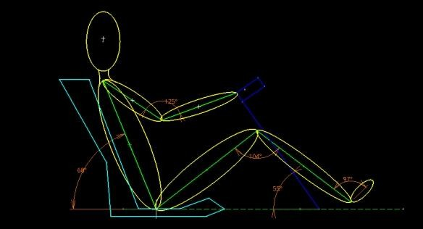
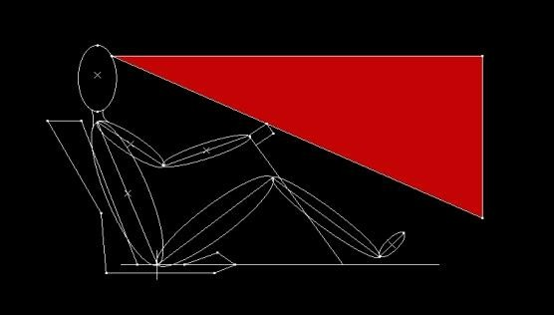
DRIVER PERCY , SAFETY & ERGONOMICS
Driver Body Part | Angle (°)
Back | 68°
Elbow | 125°
Knee | 140°
Ankle | 97°
Thigh-to-horizontal | 55°
Safety considerations
Kill switches( brake over travel, external access, drivers cockpit)
Fire extinguisher
Dot rated helmet
SFI rated driver’s suit
Gloves, shoes, neck support
List of necessary equipment
Helmets
Seatbelts
Protective barriers
Track lighting
Timing system
Track cleaning equipment
Kart maintenance tools
Safety nets
Fire extinguishers
First aid kits

Slide 16
GANTT CHART
Task No | Task Description | Start Date | End Date | Duration (Weeks)
1 | Concept & Objective Definition | Week 1 | Week 2 | 2
2 | Literature Review / Research | Week 2 | Week 3 | 2
3 | Benchmarking / Comparing Existing Electric Kart Models | Week 2 | Week 3 | 2
4 | CAD Modeling (Chassis, Frame & Components) | Week 3 | Week 5 | 3
5 | Bill of Materials (BOM) Preparation | Week 4 | Week 5 | 2
6 | Component Selection (Motor, Battery, Controller) | Week 4 | Week 5 | 2
7 | Simulation & Analysis (ANSYS, Stress & Thermal) | Week 5 | Week 6 | 2
8 | Procurement of Materials & Components | Week 6 | Week 7 | 2
9 | Fabrication / Manufacturing of Chassis & Parts | Week 7 | Week 9 | 3
10 | Assembly of Components & Wiring | Week 8 | Week 9 | 2
11 | Testing & Troubleshooting (Multiple Iterations) | Week 9 | Week 10 | 2
12 | Performance Validation & Optimization | Week 10 | Week 11 | 2
13 | Final Report, Documentation & Bill of Materials | Week 10 | Week 11 | 2
14 | Presentation & Project Submission | Week 11 | Week 12 | 1

Slide 17
PIE CHART WEIGHT DISTRIBUTION OF THE VEHICLE

Slide 18
THANK YOU

